Slide 1

Database project Final Presentation Fantasy Football Manager
PRESENTED BY
ANDREW PERRONE - 1315988
SRI SAKTICHARAN - 1337576
AQIB AHSAN – 1333611

Slide 2

Problem :
In Fantasy Premier League, there is a need for a robust and efficient SQL database to store and manage player data, team information, and match statistics. This database will serve as the backbone of the fantasy game, allowing users to make informed decisions and track their team's performance.

Slide 3

Motivation :
The motivation behind creating a SQL database for Fantasy Premier League is to provide a seamless and user-friendly experience for fantasy football enthusiasts. By centralizing all relevant data in one place, users can easily access and analyze player statistics, team performance, and league standings.

Slide 4

Applications
The SQL database will be used by both players and administrators of the Fantasy Premier League game. Players can use the database to research players, analyze performance trends, and make informed transfers and captaincy choices. Administrators can leverage the database to manage leagues, track user activity, and generate reports on game performance.

Slide 5
Database Design & Implementation
ER Diagram
Schema
The ER diagram represents the entities and their relationships in the database. It includes entities such as 'Player', 'Team', 'Fixture', 'User', and 'League', along with their attributes and relationships.
Based on the ER diagram, we implemented certain schema for the Fantasy Premier League database
Data
SQL Statements
Records of the users, matches, teams and players
are stored.
We used SQL statements to achieve various tasks, such as:
•Inserting player data into the 'Player' table.
•Updating team information in the 'Team' table.
•Querying fixture data using SQL SELECT statements.
•Managing user data in the 'User' table.
•Handling league information in the 'League' table.

Slide 6
Schema
Based on the ER diagram, we implemented following schema for the Fantasy Premier League database
Season | season_id,startDate,endDate
fantasyLeague | fantasyleague_id ,fantasyleague_name
UserTeamStats | UserTeamID,SeasonID,matches_played,wins,losses,goals,goals_conceded,clean_sheets
teamStats | team_id,season_id,matches_played,wins,losses,goals,goals_conceded,clean_sheets
league | league_id,league_name
userTeam | userteam_id,display_name,full_name,team_name,email,password,budget
team | team_id,team_name,league_id
fantasyLeagueMember | fantasyleague_id ,fantasyleague_name

Slide 7
Schema Continued….
player | player_id,player_name,cost,pos,team_id,league_id
fantasyTeamMember | userteam_id,player_id,pos
fixture | fixture_id,gameweek,fixture_date,location,league_id,season_id,home_team_id,home_team_goals,away_team_id,away_team_goals,draw.
Fantasyfixture | fixture_id,gameweek,fantasyleague_id,season_id,home_team_id,home_team_goals,away_team_id,away_team_goals,draw.
playerStats | player_id, season_id , apearances,wins,losses ,goals,goals_conceded, assists ,passes, crosses ,blocked_shots, clearance, interception

Slide 8
ER Diagram

Slide 9
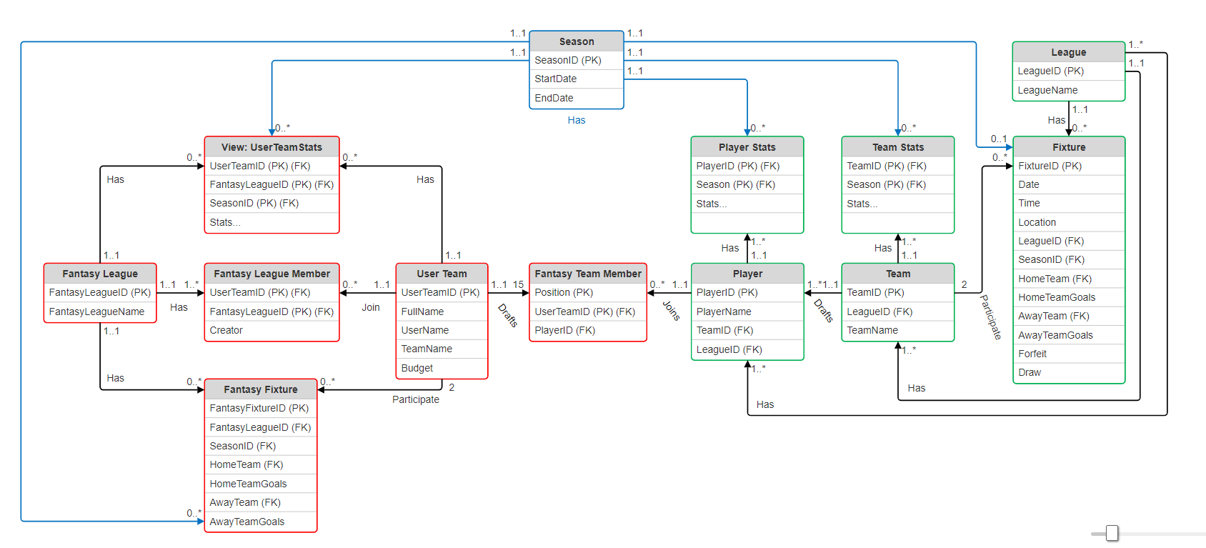

Slide 10
PROJECT DEMO
we will demonstrate the Fantasy Premier League SQL database project and explain its features.
Player Data
Team Data
Fixture Data
League Data
Season Data

Slide 11
Conclusions
Main Contributions
What Worked
What Did Not Work
Created a comprehensive SQL database for Fantasy Premier League data.- Implemented efficient querying and data retrieval methods.- Developed a user-friendly interface for easy database management.
The SQL database structure proved to be effective in storing and organizing Fantasy Premier League data.- The querying methods provided fast and accurate results for data analysis. We got stats to update after a fantasy game was played.
Some data inconsistencies were encountered during the database creation process, requiring additional cleaning and validation steps. Tried to combine real and fantasy relations into a single relation.

Slide 12
Consideration for future :
We want to get more data from the fantasy premier league API and we want the better simulation of fantasy games compared to the real games.
Enhance data cleaning and validation processes to ensure data consistency and accuracy.- Optimize query performance to improve overall system efficiency

Slide 13

THANK YOU!

